Slide 1
Relation Extraction
What is relation extraction?

Slide 2
Extracting relations from text
Company report: “International Business Machines Corporation (IBM or the company) was incorporated in the State of New York on June 16, 1911, as the Computing-Tabulating-Recording Co. (C-T-R)…”
Extracted Complex Relation:
Company-Founding
Company IBM
Location New York
Date June 16, 1911
Original-Name Computing-Tabulating-Recording Co.
But we will focus on the simpler task of extracting relation triples
Founding-year(IBM,1911)
Founding-location(IBM,New York)

Slide 3
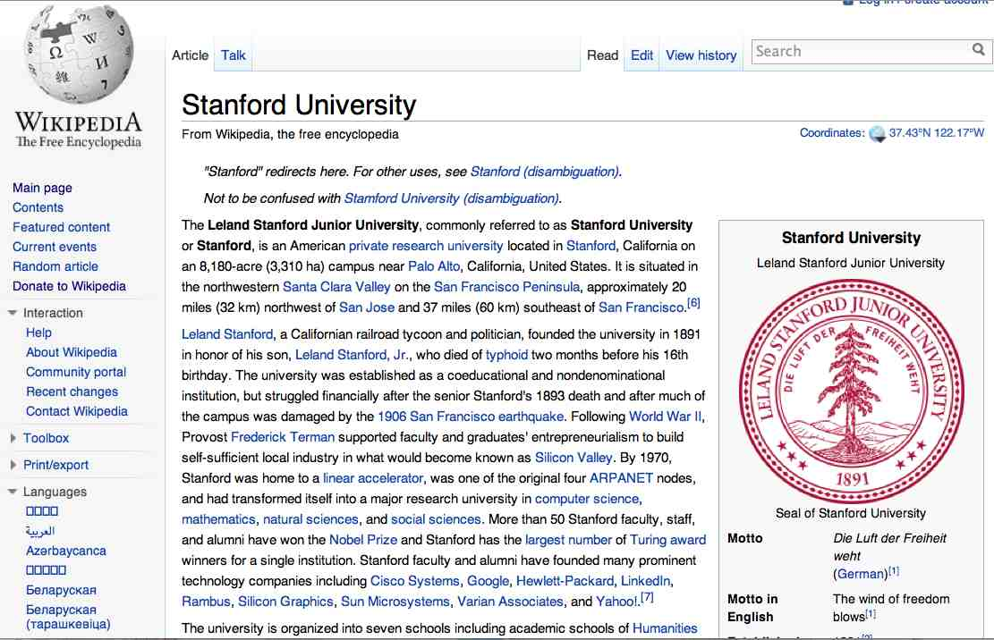
Extracting Relation Triples from Text
The Leland Stanford Junior University, commonly referred to as Stanford University or Stanford, is an American private research university located in Stanford, California … near Palo Alto, California… Leland Stanford…founded the university in 1891
Stanford EQ Leland Stanford Junior University
Stanford LOC-IN California
Stanford IS-A research university
Stanford LOC-NEAR Palo Alto
Stanford FOUNDED-IN 1891
Stanford FOUNDER Leland Stanford

Slide 4
Why Relation Extraction?
Create new structured knowledge bases, useful for any app
Augment current knowledge bases
Adding words to WordNet thesaurus, facts to FreeBase or DBPedia
Support question answering
The granddaughter of which actor starred in the movie “E.T.”?
(acted-in ?x “E.T.”)(is-a ?y actor)(granddaughter-of ?x ?y)
But which relations should we extract?

Slide 5
Automated Content Extraction (ACE)
17 relations from 2008 “Relation Extraction Task”

Slide 6
Automated Content Extraction (ACE)
Physical-Located PER-GPE
He was in Tennessee
Part-Whole-Subsidiary ORG-ORG
XYZ, the parent company of ABC
Person-Social-Family PER-PER
John’s wife Yoko
Org-AFF-Founder PER-ORG
Steve Jobs, co-founder of Apple…

Slide 7
UMLS: Unified Medical Language System
134 entity types, 54 relations
Injury disrupts Physiological Function
Bodily Location location-of Biologic Function
Anatomical Structure part-of Organism
Pharmacologic Substance causes Pathological Function
Pharmacologic Substance treats Pathologic Function

Slide 8
Extracting UMLS relations from a sentence
Doppler echocardiography can be used to diagnose left anterior descending artery stenosis in patients with type 2 diabetes
⬇
Echocardiography, Doppler DIAGNOSES Acquired stenosis

Slide 9
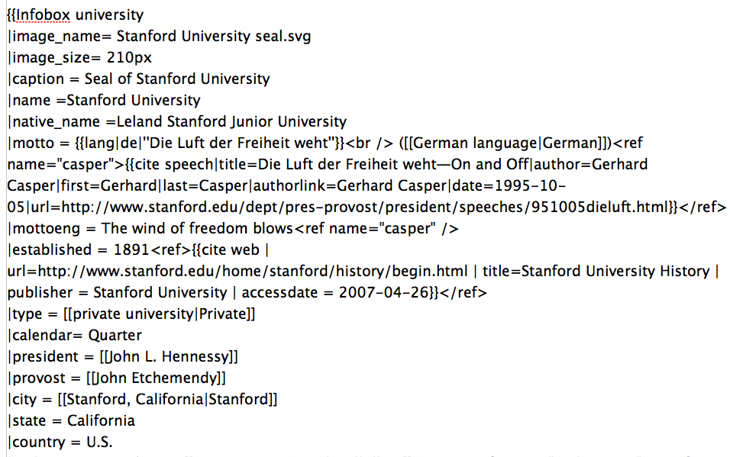
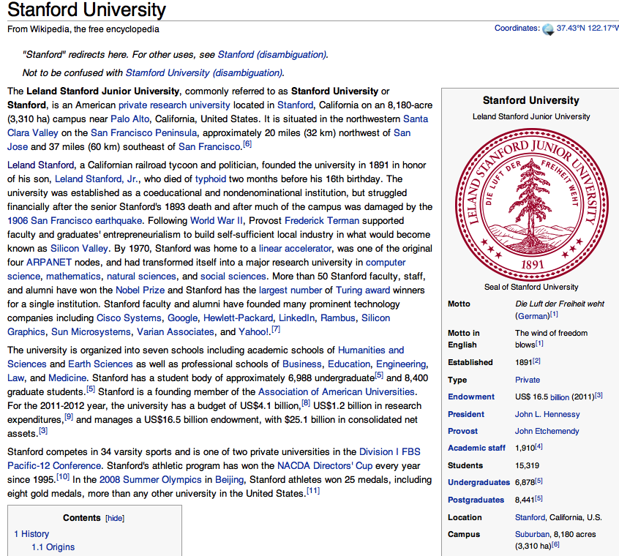
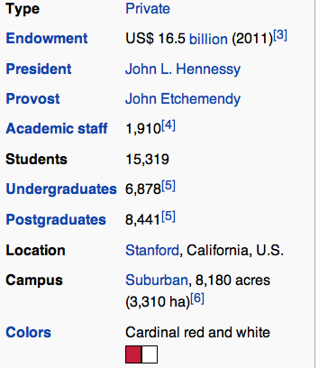
Databases of Wikipedia Relations
Wikipedia Infobox
Relations extracted from Infobox
Stanford state California
Stanford motto “Die Luft der Freiheit weht”
…

Slide 10
Relation databases that draw from Wikipedia
Resource Description Framework (RDF) triples
subject predicate object
Golden Gate Park location San Francisco
dbpedia:Golden_Gate_Park dbpedia-owl:location dbpedia:San_Francisco
DBPedia: 1 billion RDF triples, 385 from English Wikipedia
Frequent Freebase relations:
people/person/nationality, location/location/contains
people/person/profession, people/person/place-of-birth
biology/organism_higher_classification film/film/genre

Slide 11
Ontological relations
Examples from the WordNet Thesaurus
IS-A (hypernym): subsumption between classes
Giraffe IS-A ruminant IS-A ungulate IS-A mammal IS-A vertebrate IS-A animal…
Instance-of: relation between individual and class
San Francisco instance-of city

Slide 12
How to build relation extractors
Hand-written patterns
Supervised machine learning
Semi-supervised and unsupervised
Bootstrapping (using seeds)
Distant supervision
Unsupervised learning from the web

Slide 13
Relation Extraction
What is relation extraction?

